Slide 1
Social Acceptance of Nomadic Virtual Reality
Forschungsseminar: MMI

Slide 2
Project Summary
Topic
The study´s topic is to find out more about the „Acceptance of Nomadic Virtual Reality“ in public places based on previous researches by performing a field study.

Slide 3
Related Work
[2] The user´s surrounding divided into public, semi public and private, plays an important role in his decision to interact with a device / fullfill gestures
Result: people feel more comfortable to perform gestures in privacy than in public
[3] VR goggles evoke competence rather than warmth
[4] The usage of VR goggles in privacy is more accepted as long as there is no pending interaction with other people

Slide 4
Method
Study Design
Independent Variable:
Gender of the actor
VR goggles / no VR goggles
Gestures / no gestures
Location, Time
Dependent Variable:
- Acceptance Rating

Slide 5
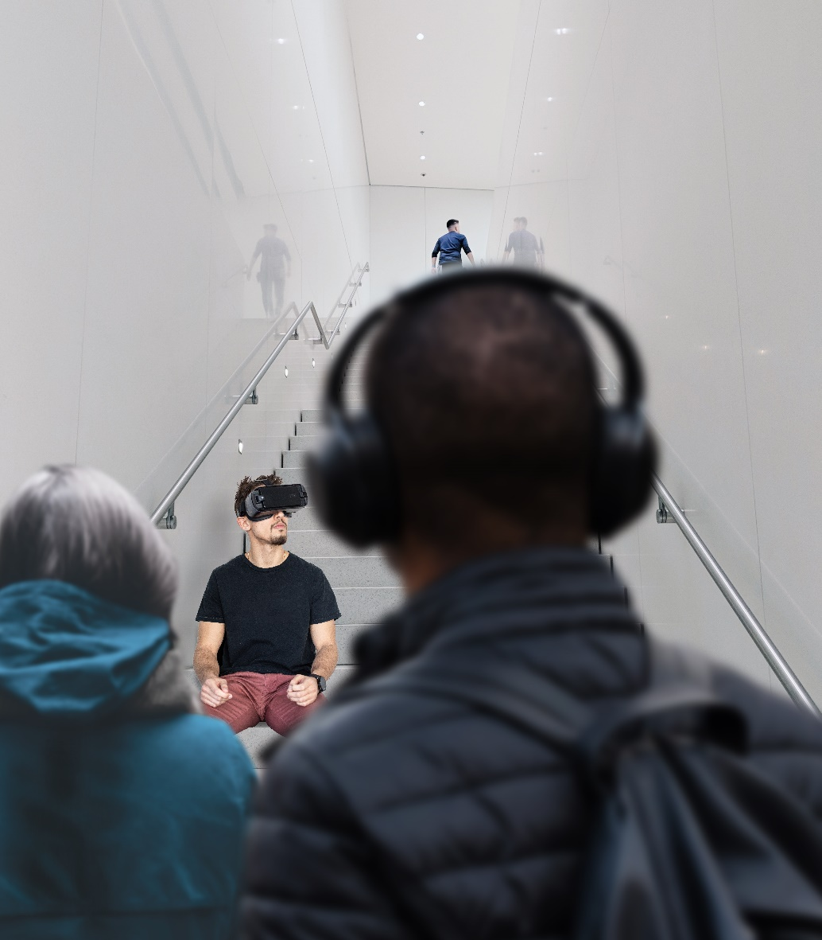
Method
Apparatus / Prototype

Slide 6
Method
Stimuli / Conditions
Gender of the actor
VR goggles / no VR goggles (baseline)
Gestures / no gestures (baseline)

Slide 7
Method
Procedure / Participant Recruiting
Actor / actress enters the chosen location and takes a seat
Let the situation act on nearby passerby
Interview nearby passerby
Each passerby fills out a demographic questionaire and a consent form
Each passerby fills out an „Acceptance Questionaire“
Hand out a reward
Each nearby passerby is a potential test person of our study

Slide 8
References
[1] Norene Kelly. 2016. The WEAR Scale: Development of a measure of the social acceptability of a wearable device. (2016).
[2] Julie Rico and Stephen Brewster. 2010. Usable gestures for mobile interfaces: evaluating social acceptability. In Proceedings of the SIGCHI Conference on Human Factors in Computing Systems. ACM, 887–896.
[3] Valentin Schwind, Niklas Deierlein, Romina Poguntke, and Niels Henze. 2019. Understanding the Social Acceptability of Mobile Devices using the Stereotype Content Model. (2019).
[4] Valentin Schwind, Jens Reinhardt, Rufat Rzayev, Niels Henze, and Katrin Wolf. 2018. Virtual reality on the go?: a study on social acceptance of VR glasses. In Proceedings of the 20th International Conference on Human-Computer

